Slide 1




PAGE 01
DATE: 30/11/2025
MODULE : BLOCKCHAIN TECHNOLOGY
DISTRIBUTED LEDGER, IMMUTABLE RECORDS AND DECENTRALIZED TRUST
TOKENIZATION, NFT’S & REAL WORLD IMPLICATIONS
PRESENTATION PRESENTED BY: MOHD NIZAM MOHD NASIR SHAIKH - 24198170
MSC IN FINTECH (MSCFTD1)

Slide 2
AGENDA
PAGE 02
1
2
ERC 20 TOKENIZATION
ERC 721 NON FUNGIBLE TOKENS NFT’s
Fungible tokens
Unique Digital Assets
3
4
Financial Realm: NASDAQ Linq
Cybersecurity: IBM Trade
Blockchain services for Finance market
Securing data with Blockchain
5
6
Manufacturing Industry: WALMART IBM’s Food Trust
Agricultural Sector: AGRI-DIGITAL
Transformation of Farming Industry
Transparency in Supply Chain
7
Blockchain Technology Future: Opportunities and Obstacles

Slide 3
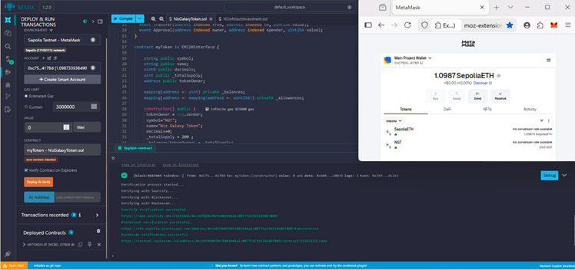
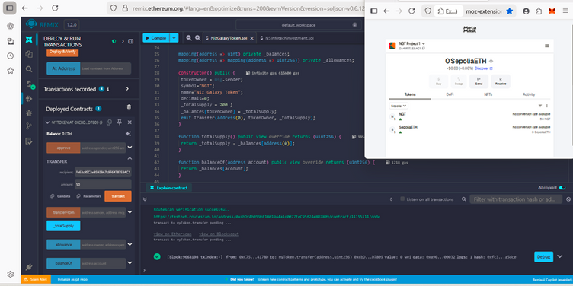
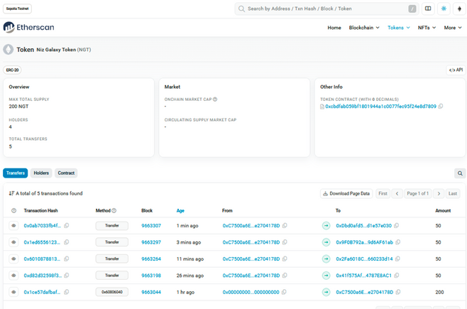
ERC20: STANDARD OF FUNGIBLE TOKENS
Contract address of Niz Galaxy Token - 0xcbdfab059bf1801944a1c0077fec95f24e8d7809.
https://sepolia.etherscan.io/token/0xcbdfab059bf1801944a1c0077fec95f24e8d7809
PAGE 03
ERC20 is a technical standard for creating and managing fungible tokens on ETH blockchain by providing rules for tokens exchange, trade and access.
As for example, I used Etherscan and Sepolia Testnet to illustrate ERC20 tokenization by creating 200 tokens as “Niz Galaxy Tokens”(NGT) and distributed each of 50 tokens to 4 NGT wallet.
01
Firstly, transferred 50 tokens to NGT wallet 1 via Remix platform through smart contract of ERC20.
Secondly, transferring of 150 tokens each to other 3 NGT wallets through MetaMask as it was quick for interconnecting to main wallet for transacting, offering convenience for future instance.
02
03
Thirdly, shown entire history of etherscan as it demonstrates all transaction of Tokens from contract deployment to distribution of tokens.

Slide 4
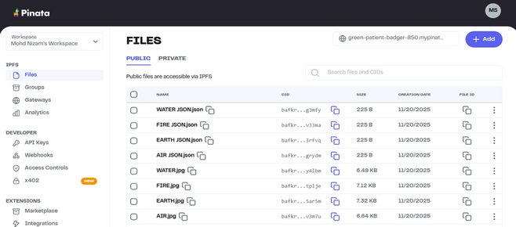
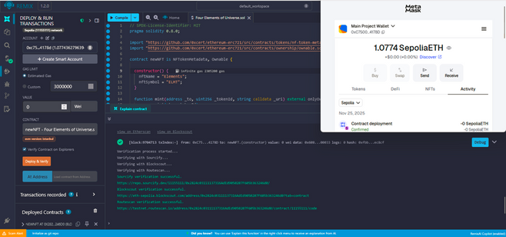
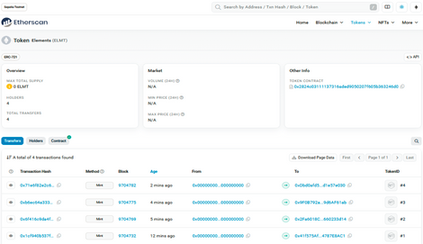
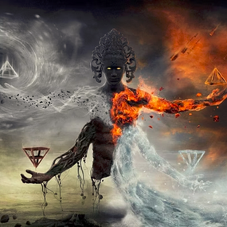
ERC721: UNIQUE NON-FUNGIBLE TOKENS(NFT’S)
Contract address of ELMT - 0x2824c03111137316AdEd9050207F605b363246d0
https://sepolia.etherscan.io/token/0x2824c03111137316aded9050207f605b363246d0
PAGE 04
ERC721 is also one of the Ethereum standards known as Non-Fungible Tokens(NFT’s), which representing unique and also immutable assets but NFT aren't exchangeable making them excellence of antique digital art.
For instance, I have created four of the Unique NFT’s as Elements-tokens plus ELMT-symbol showcasing Air, Earth, Fire and Water and distributed each to 4 NGT wallets.
01
Firstly, I uploaded my 4 NFT’s and link of the image from Pinata into JSON codes including title, description in Pinata.
Secondly, on Remix platform via smart contract of ERC721, I deployed my contract successfully and minted all of the 4 NFT’s through link from JSON codes and wallet address of 4 NGT accounts.
02
03
Thirdly, demonstration of history of Etherscan as it highlight all 4 of NFT’s Tokens from minting to implementing of digital assets.

Slide 5
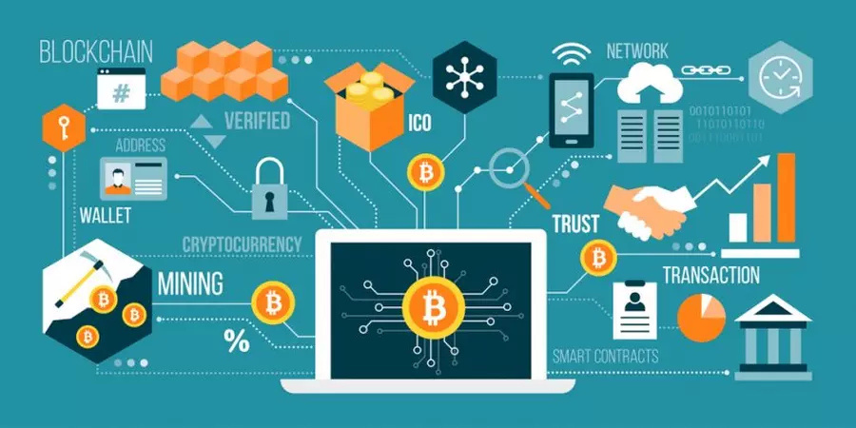
CASE STUDY: FINANCIAL REALM - NASDAQ LINQ
PAGE 05
Blockchain’s smart contracts and DLT are transforming NASDAQ Linq finances by offering transparent and efficient operations by creating immutable records. However, universal adoption will face challenges due to high cost of setup and coordination issues.
PROMPT SETTLEMENTS
01
Reduces transaction time from 3 days to minutes.
LOWER RISK
02
Less backup funds required, making available capital.
LESS PAPERWORK COST
03
Digital ownership data replaces physical certificates.
EFFICIENT QUALITY AUDITING
04
Real time monitoring and verification updates of holdings.

Slide 6
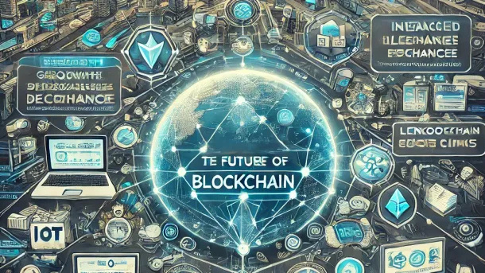
CASE STUDY: CYBERSECURITY DOMAIN - IBM TRADE
PAGE 06
IBM Trade cybersecurity enhanced through Blockchain’s technologies by protecting data and systems. They offer theft resistant solutions for sharing and managing sensitive threat intelligence.
TRUSTED DATA EXCHANGE
01
Permissive blockchain allows securing policy based sharing of threat data.
02
DECENTRALIZED ASSURANCE
Network nodes run by each organization which removes single individual dependancy.
03
REPUTATION SYSTEM
Tracking contribution without exposing weakness to specific organizations which promotes participation.
REWARD PROCESSES
04
Encourages by sharing incentives to based on high level reputation through granting access to premium intelligence.

Slide 7
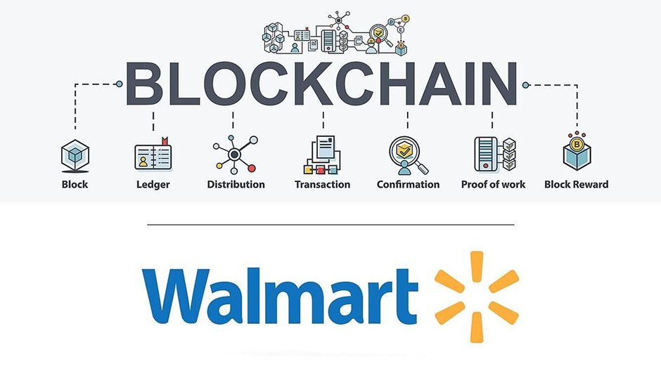
CASE STUDY: MANUFACTURING INDUSTRY - WALMART ‘S IBM FOOD TRUST
PAGE 07
Blockchain remodeling supply chain and manufacturing of Walmart food trust industry by improving visibility and security. It reduces communication problems and data confirmation time which leads to better quality products at lower costs.
01
FOOD SAFETY
Simultaneous supervising of temperature, humidity & movement from IOT sensors.
02
SUPPLY CHAIN HONESTY
Verified data information is accessible to all stakeholders.
03
QUICK PRODUCT TRACKING
Reduces tracking time from a week to seconds.
04
COST REDUCTION
Removing unnecessary data verification which minimizes expenses.

Slide 8
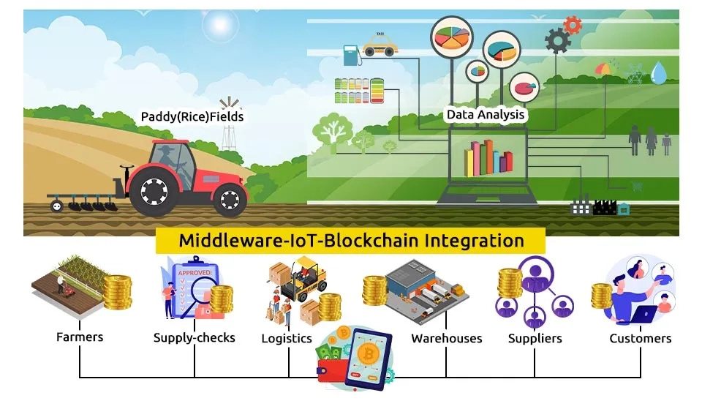
CASE STUDY: AGRICULTURAL SECTOR - AGRIDIGITAL
PAGE 08
Blockchain is reshaping and expanding many agriculture sectors and the 1 initiative by Agri-Digital startup to function blockchain for improved grain deliveries, ownership transfers and payments.
01
SUSTAINABLE MANAGEMENT
Traces carbon footprints, water and pesticides usage per batch.
02
TOKENIZED LABELS
Digital records via smart contract of physical grain deliveries and ownership transfers.
03
CLIMATE RISK INSURANCE
Automates payout via smart contracts for climate fluctuation.
04
FARMER & BUYER TRUST
Providing QR codes for product information as build trust and connection between them.

Slide 9
OPPORTUNITIES AND OBSTACLES
PAGE 09
01
02
03
04
05
SCALABILITY & INTEGRATION
REGULATORY CLARITY
INDUSTRY COLLABORATION
TRUST & SECURITY
PROMOTING DECENTRALIZATION
Developing clear legal frameworks for decentralized systems
Assuring data accuracy while minimizing smart contract vulnerabilities
Targeting seamless integrations system and transaction speed
Encouraging shared infrastructure & mass adoption
Transforming traditional industries and business models
Currently blockchain providing benefits in several businesses it is no longer just a theory because of potential, security and transparency its applicable everywhere but success depends on collaboration, clear regulations and broad adoption. Despite of its significant disruption, institutions need to quickly adjust than future will be shapes by solving scalability problems, enhancing data accuracy and creating integrated systems.

Slide 10
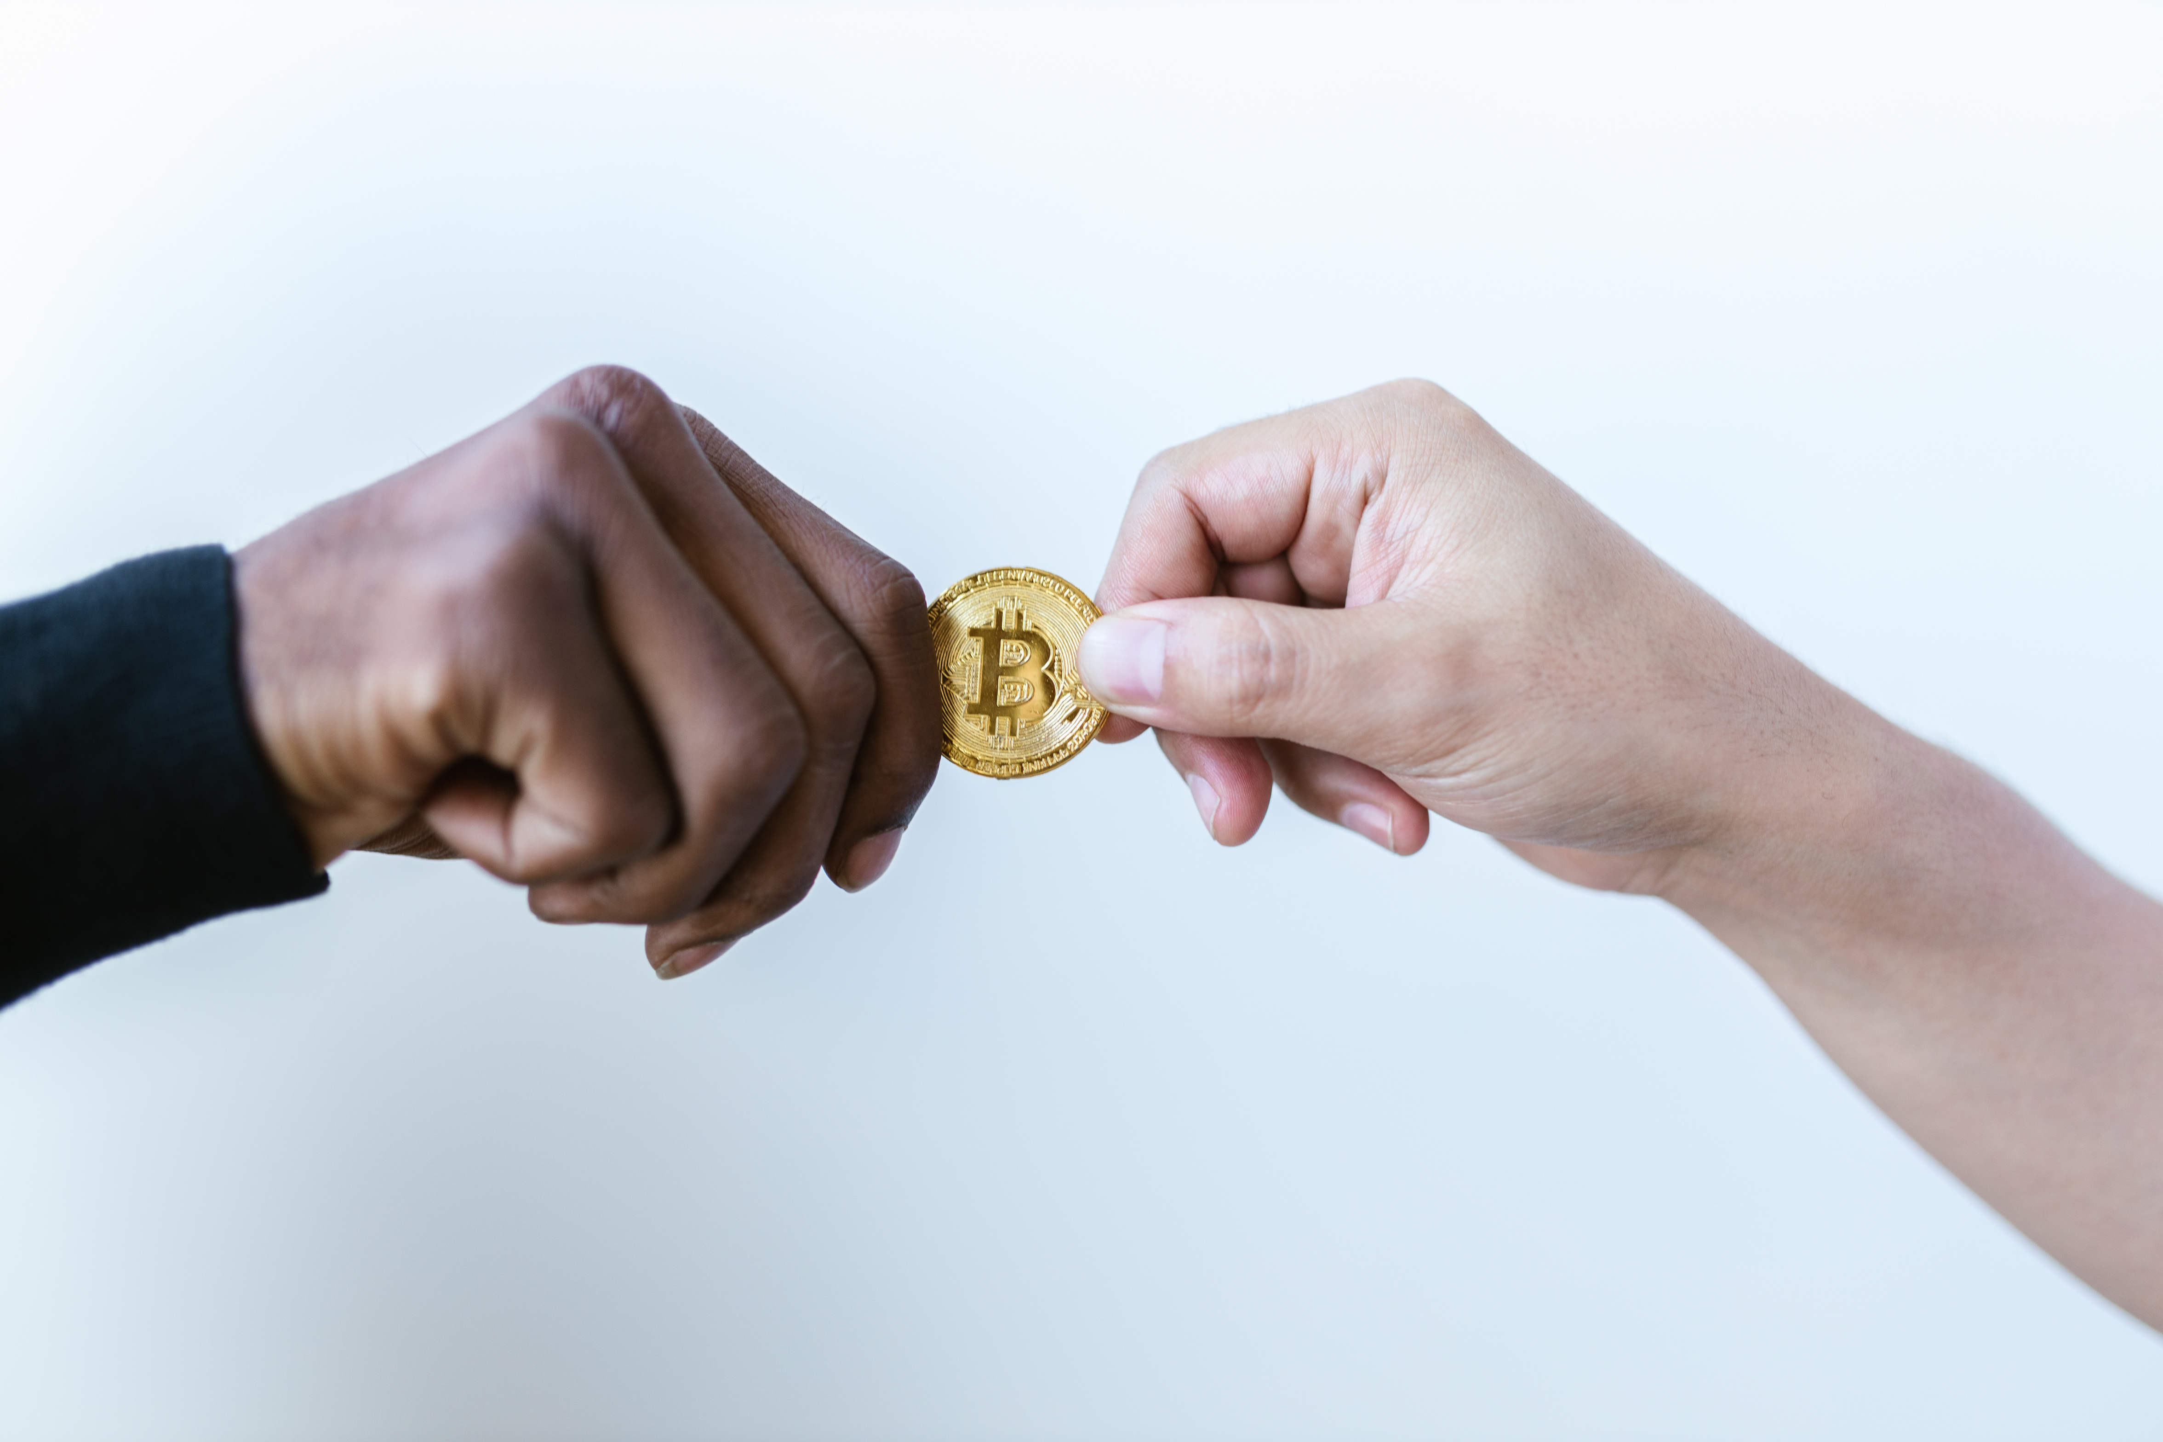
PAGE 10
THANK YOU FOR YOUR ATTENTION
Thank you for watching the exploration of blockchain technology and its transformative power. I hope this presentation has inspired new ideas and perspectives about how smart contracts and DLT shapes our world.
MOHD NIZAM
NATIONAL COLLEGE OF IRELAND
MSC IN FINTECH (MSCFTD1)
Blockchain Technologies
EMAIL
X24198170@student.ncirl.ie

